Slide 1

AI-Powered Quiz Generation and Evaluation Platform
By Rohit M. Ghosarwadkar and Seamus Rodrigues MSc AI, Part 1 – Goa University

Slide 2
Introduction
AI is not just disrupting but it's revolutionizing education.
How do we evolve in 2025 as teachers and students alike?
Project: Automate quiz creation, delivery, evaluation.
Benefits: Instant feedback, actionable insights for educators.

Slide 3
Problem Statement
Time-consuming quiz creation.
Delayed feedback limits timely intervention.
Lack of personalization.
Fragmented toolchain.
Need: Unified AI-enabled assessment platform.

Slide 4

Objectives
Auto-generate quiz questions.
Enable question curation by teachers.
Deliver & evaluate quizzes in real time.
Offer immediate, individualized feedback.

Slide 5
Approach
Upload PDF → Text Extraction → Vectorization.
Question Generation: LLMs generate structured questions.
Selection: Teachers curate quizzes.
Delivery: Students attempt quizzes on web interface.
Evaluation: LLM evaluates answers.

Slide 6
Retrieval-Augmented Generation (RAG)
Combines Retriever + Generator (Llama-3).
Contextual flexibility without retraining.
Cost-efficient and scalable for diverse content.
Vector store: Weaviate used for retrieval.

Slide 7
RAG vs Fine-Tuning
RAG | Fine-Tuning
Dynamic adaptability | Domain specialization
Lower cost | Lower runtime
Ideal for varied content | Best for niche topics

Slide 8
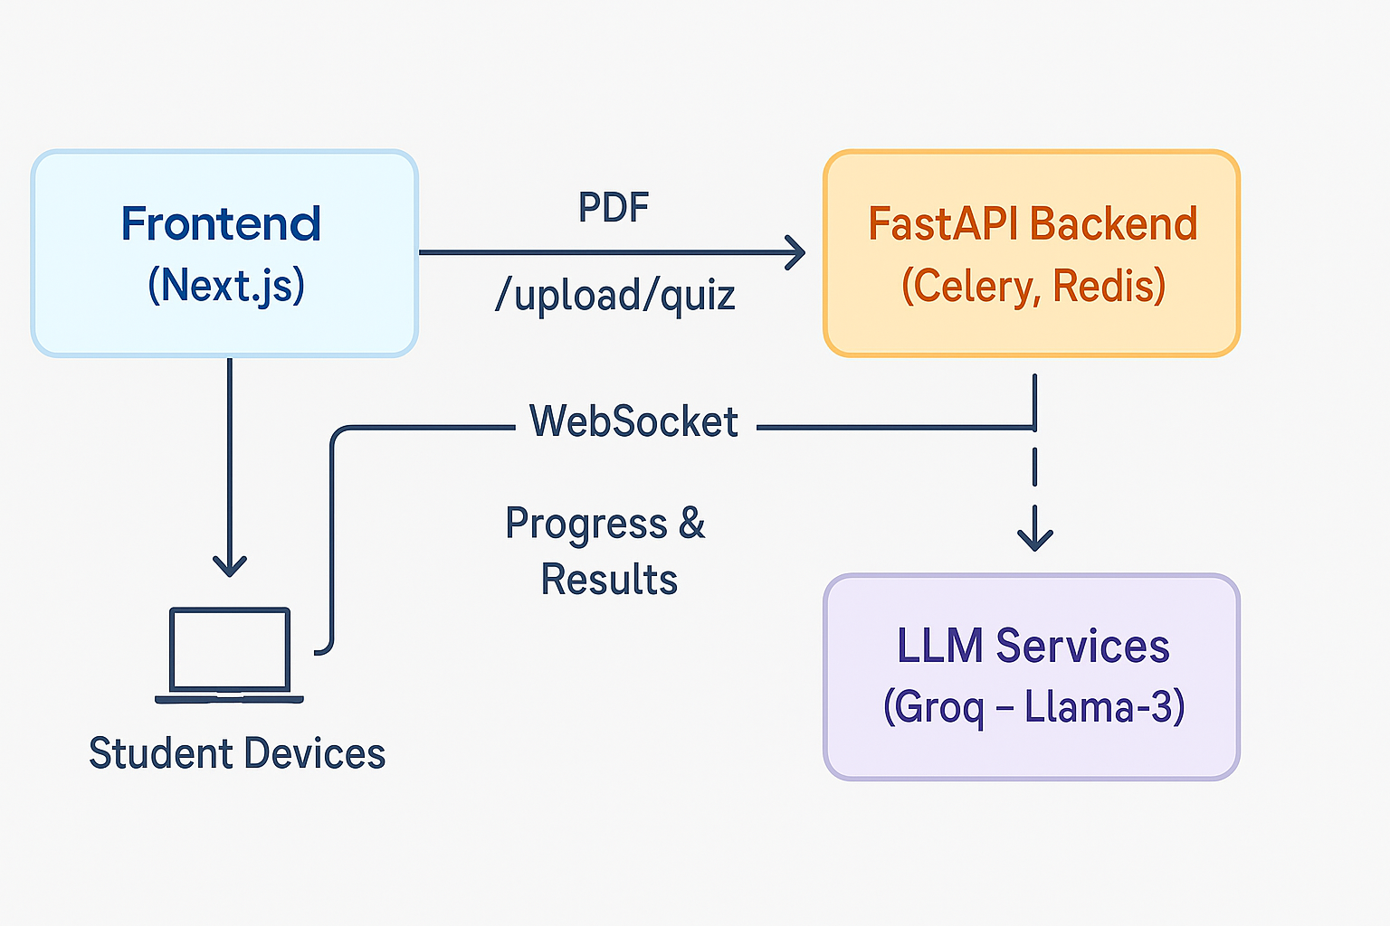
System Architecture

Slide 9
Component Details
File Upload: Save & track upload progress.
PDF Vectorizer: Sentence splitting for embeddings.
Vector Operations: Storage in Weaviate.
Question Generation: JSON output via LLM.
Evaluation Service: Batch correctness evaluation.

Slide 10
Technology Stack
Languages: Python 3.11, TypeScript
Frameworks: FastAPI, Celery, Next.js, React
LLM Provider: Groq Cloud (Llama-3-70B)
DevOps: Docker, GitHub Actions, Vercel

Slide 11
Challenges & Mitigations
Parsing Errors → Pymupdf + OCR fallback.
Latency → Optimal chunk sizing.
Scalability → Redis + Celery workers.
User Experience → Card-based quiz builder.

Slide 12

Future Work
Multilingual
App based
More advanced prompting

Slide 13
Conclusion
Unified AI platform for quiz creation, delivery, and evaluation.
Real-time feedback makes better learning interesting
Powered by Retrieval-Augmented Generation (RAG) for dynamic, context-aware quiz creation.
RAG is a powerful method to "not reinvent the wheel" and focus on faster solutions and deployment

Slide 14
References
FastAPI Documentation: https://fastapi.tiangolo.com/
Weaviate Documentation: https://weaviate.io/developers/weaviate
Medium articles on RAG
Celery Documentation: https://docs.celeryproject.org/
NLTK Documentation: https://www.nltk.org/

